Slide 1

Behind the Magic: SignalR Demystified
Keith Telle
Lead Software Engineer
Bit Wizards
Notes:
<number>

Slide 2
Gulf Coast DOTNET User Group April 19, 2015
http://www.gulfcoastdotnet.org
@GCDNUG
Notes:
<number>

Slide 3
What is SignalR?
A library for ASP.NET developers
Adds real-time web functionality to any ASP.NET application
Allows server side code to push content to clients
A simple, high-level API for doing server to client RPC
Adds useful hooks for doing connection management
Connect/Disconnect events
Grouping connections
Authorization
Notes:
<number>

Slide 4
What can I do with SignalR?
Any time a user refreshes a web page to see new data, or the page implements Ajax long polling to retrieve new data, is candidate for using SignalR
Examples
Chat room applications
Real-time monitoring applications
Job progress updates
Real time forms
Notes:
<number>

Slide 5
How does SignalR work?
SignalR takes advantage of several transports, automatically selecting the best available transport given the client's and server's best available transport
SignalR will use WebSockets under the covers when it's available, and gracefully fall back to other techniques and technologies when it isn't
WebSockets is a protocol providing full-duplex communications channels over a single TCP connection
A secure version of the WebSocket protocol is implemented in Firefox 6, Safari 6, Google Chrome 14, Opera 12.10 and Internet Explorer 10
Notes:
<number>

Slide 6
How does SignalR work?
Fallbacks
Server-Sent Events (All but IE)
A technology where a browser receives automatic updates from a server via HTTP connection
Forever Frame (IE only)
Creates a hidden IFrame which makes a request to an endpoint on the server that does not complete
The server then continually sends script to the client which is immediately executed, providing a one-way realtime connection from server to client
The connection from client to server uses a separate connection from the server to client connection
(Ajax) Long polling
Polls the server with a request that stays open until the server responds
The connection closes, and a new connection is requested immediately
Some latency on reset
Notes:
<number>

Slide 7
How does SignalR work?
SignalR provides persistent connection between the client and the server
SignalR provides two models for communication
Persistent Connection API
Direct access to the low level communication protocol
Hubs
High Level API written over PersistentConnection
Allows the client and server to call methods on each other directly
Allow you to pass strongly typed parameters to methods, enabling model binding
Notes:
<number>

Slide 8
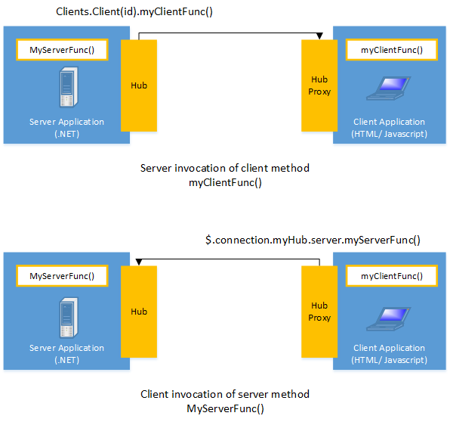
How does SignalR work?
from "Introduction to SignalR" by Patrick Fletcher, http://www.asp.net/signalr/overview/getting-started/introduction-to-signalr
Notes:
<number>

Slide 9
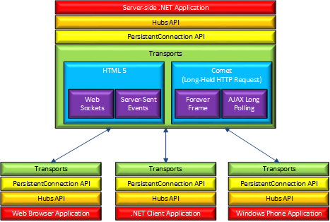
How does SignalR work?
from "Introduction to SignalR" by Patrick Fletcher, http://www.asp.net/signalr/overview/getting-started/introduction-to-signalr
Notes:
<number>

Slide 10
How does SignalR work?
Choosing a communication model
Most applications should use the Hubs API
The Connections API could be used in the following circumstances:
The format of the actual message sent needs to be specified
The developer prefers to work with a messaging and dispatching model rather than a remote invocation model
An existing application that uses a messaging model is being ported to use SignalR
Notes:
<number>

Slide 11
How does SignalR work?
“What transports does SignalR use in various browsers to mimic a real-time connection?” https://github.com/SignalR/SignalR/wiki/Faq#what-transports-does-signalr-use-in-various-browsers-to-mimic-a-real-time-connection
Specifying a transport
connection.start({ transport: 'longPolling' });
connection.start({ transport: ['webSockets','longPolling'] });
webSockets, foreverFrame, serverSentEvents, longPolling
To enable logging for your hub's events in a browser, add the following command to your client application:
$.connection.hub.logging = true;
Notes:
<number>

Slide 12
How do I get SignalR?
NuGet
Install-Package Microsoft.AspNet.SignalR
Install-Package Microsoft.AspNet.SignalR.Sample
Notes:
<number>

Slide 13
What license does SignalR use?
Apache 2.0 License https://www.apache.org/licenses/LICENSE-2.0
tl;dr Legal
Apache License 2.0 https://tldrlegal.com/license/apache-license-2.0-%28apache-2.0%29
Notes:
<number>

Slide 14
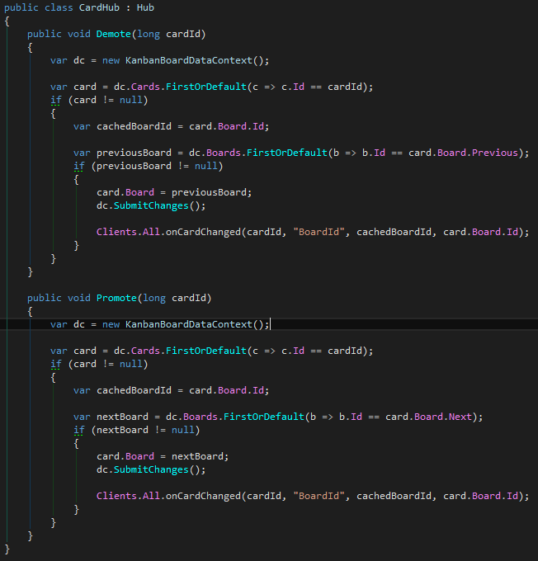
Can I see SignalR in action?
Notes:
<number>

Slide 15
Can I see SignalR in action?
Kanbanboard https://bitbucket.org/telleck/kanbanboard
Notes:
<number>

Slide 16
Where can I find out more?
SignalR @ The ASP.NET Site, http://www.asp.net/signalr
“Introduction to SignalR” Patrick Fletcher http://www.asp.net/signalr/overview/getting-started/introduction-to-signalr
“Supported Platforms” Patrick Fletcher http://www.asp.net/signalr/overview/getting-started/supported-platforms
“Tutorial: Getting Started with SignalR 2 and MVC 5” Tim Teebken and Patrick Fletcher http://www.asp.net/signalr/overview/getting-started/tutorial-getting-started-with-signalr-and-mvc
Notes:
<number>

Slide 17
Where can I find out more?
“A first look at SignalR” Rick Strahl http://weblog.west-wind.com/posts/2013/May/22/A-first-look-at-SignalR
“Asynchronous scalable web applications with real-time persistent long-running connections with SignalR” Scott Hanselman http://www.hanselman.com/blog/AsynchronousScalableWebApplicationsWithRealtimePersistentLongrunningConnectionsWithSignalR.aspx
“Introduction to SignalR” Rohit Taralekar http://www.codeproject.com/Tips/590660/Introduction-to-SignalR
Notes:
<number>

Slide 18
Where can I find out more?
ASP.NET SignalR Incredibly simple real-time web for .NET http://signalr.net/
SignalR @ GitHub, https://github.com/SignalR SignalrR/SignalR, https://github.com/SignalR/SignalR SignalR/Samples, https://github.com/SignalR/Samples
Pluralsight, http://www.pluralsight.com/search/?searchTerm=signalr
ShootR game, http://shootr.signalr.net/
Notes:
<number>

Slide 19
Wait, I have a question!
Keith Telle Lead Software Engineer Bit Wizards keith@bit-wizards.com Twitter @BitWiz_Keith GitHub @bwkeith
Gulf Coast DOTNET Users Group http://www.gulfcoastdotnet.org @GCDNUG
Notes:
<number>

Slide 20

Notes:
<number>

